Slide 1
Sales Target Dashboard
By Amit Sawant

Slide 2
Objective
Track and analyze the performance of salesmen against their sales targets.
Provide clear KPIs and visual insights for decision-making.
Enable interactive filtering by product, category, sale type, and payment mode.

Slide 3
Data Overview
Input Data- This sheet contains the raw sales transactions exactly as they occurred. Contains raw sales transaction data with date, product details, category, quantity, sale type, payment mode, prices, and total values.
Master Data- This is a reference table containing detailed information about each product. It Links product IDs to name, category, unit, and standard buying/selling prices.

Slide 4
Dashboard Features
Target vs Achievement comparison.
Sales breakdown by salesman, category, sale type, and payment mode.
Interactive slicers for dynamic data filtering.
Visual charts for quick insights.
Pivot tables and Excel formulas for calculations.

Slide 5
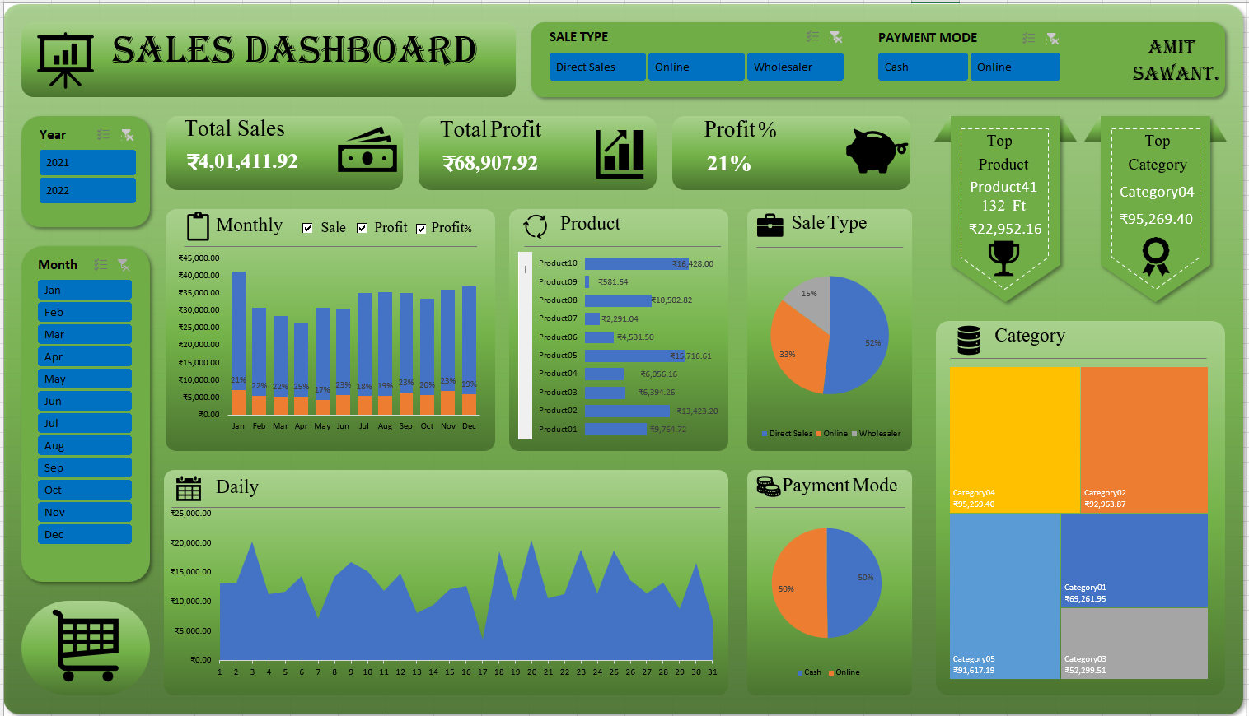
Dashboard Preview

Slide 6
Key Insights
Top-performing months and categories identified.
Most profitable product lines determined.
Sales split by payment mode and sale type analyzed.
Contribution of each salesman to total revenue highlighted.

Slide 7
Conclusion & Next Steps
Dashboard offers a clear overview of sales performance.
Helps management take quick and informed decisions.
Future scope: Automate data refresh and integrate with live sales systems.

